Slide 1
Microservice Solution: Tools, Patterns & Practices
Halil İbrahim Kalkan

Slide 2
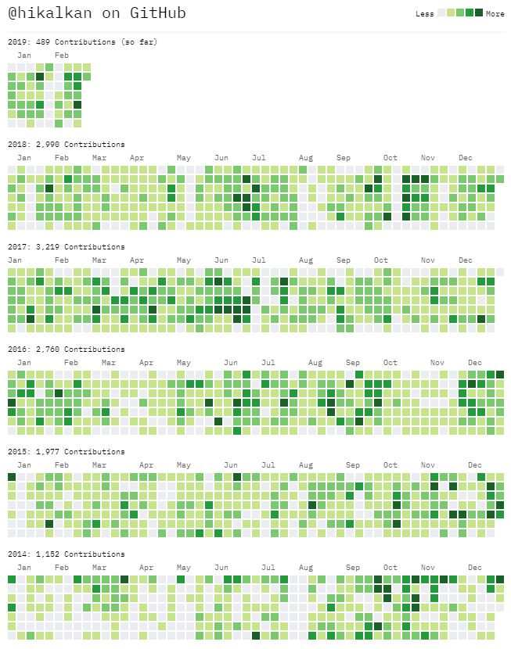

About Me
Halil İbrahim Kalkan
Web: halilibrahimkalkan.com
Github: @hikalkan
Twitter: @hibrahimkalkan

Slide 3
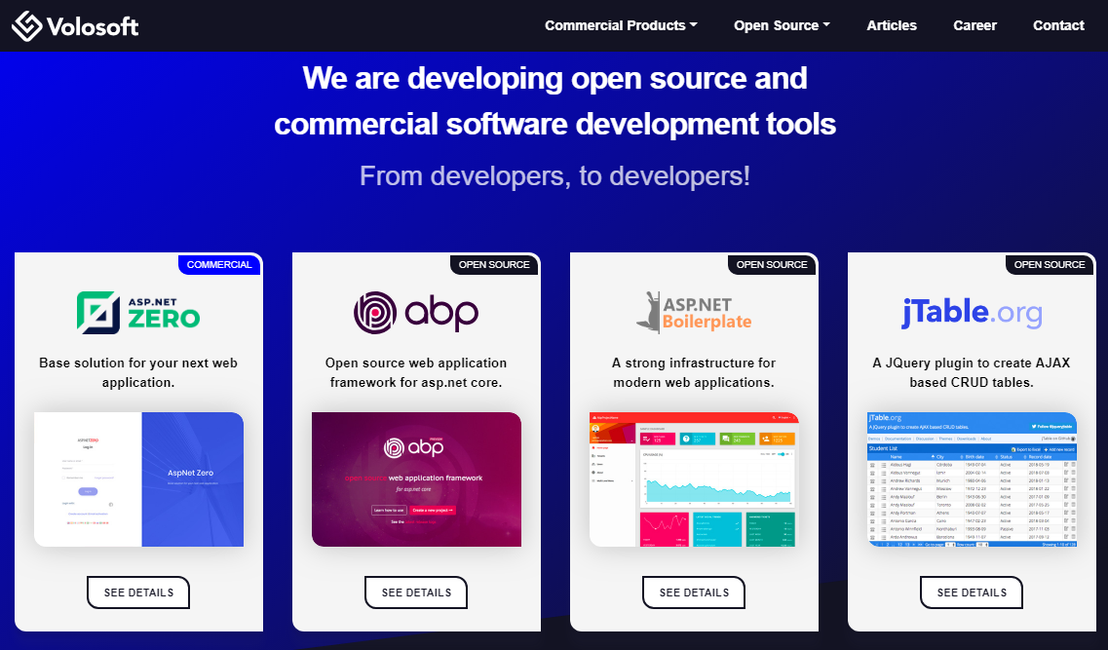

Slide 4
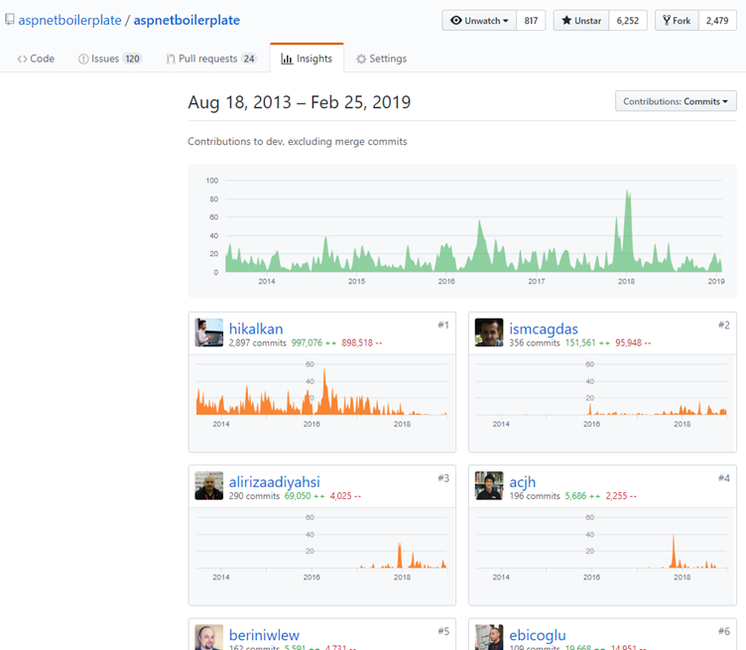
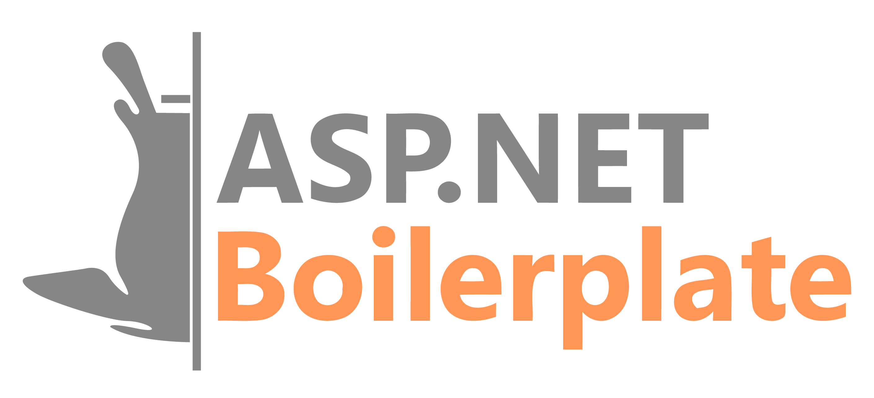
ASP.NET Boilerplate
6.000+ stars on GitHub
1.000.000+ downloads on Nuget
Visit https://aspnetboilerplate.com

Slide 5
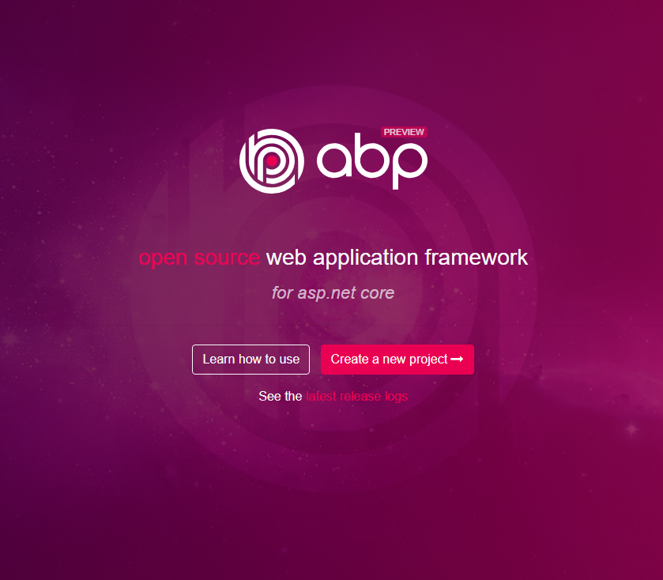
ABP vNext
Visit https://abp.io
Modular architecture
Microservice focused
Domain Driven Design
Multi-Tenancy
Virtual File System
Dynamic Forms & Tag Helpers
Theming
Background jobs
Dynamic HTTP Client Proxies
Database Agnostic
…

Slide 6
Agenda
Part-I: From Monolithic to Microservice: Challenges of the Distributed Architecture
Part II: The Implementation
Part III: Microservice compatible, layered module development model
Part IV: Running on docker containers

Slide 7
Part-I From Monolithic to Microservice Challenges of the Distributed Architecture

Slide 8
Part-I: From Monolithic to Microservice Simple Monolithic Application
Single programming language/platform
Dependency Injection & simple method calls.
Easy to create database transaction scopes.
In-process & transactional messaging / event bus.
Monolithic Application
(UI, APIs, Services, DTOs, Entities, Repositories…)
Single Database

Slide 9
Part-I: From Monolithic to Microservice Layered Monolithic Application
Organize codebase better by layering
Domain Driven Design (DDD) offers four fundamental layers:
Domain Layer
Application Layer
Presentation Layer
Infrastructure Layer
Infrastructure
Layer
Presentation Layer
Application Layer
Domain Layer
Single Database

Slide 10
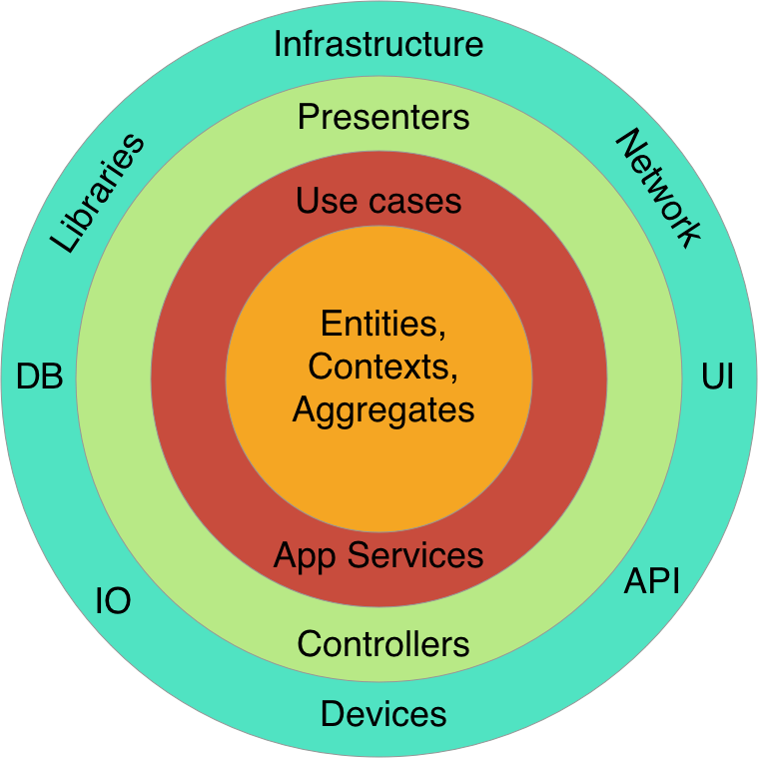
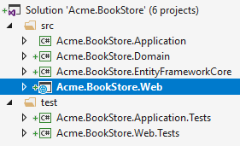
Part-I: From Monolithic to Microservice Layered Monolithic Application
Clean Architecture / Onion Architecture
Each layer can only depend on the layer directly inside it
More organized, maintainable, reusable & testable code base.
Each layer can be a separated project (csproj file)

Slide 11
Part-I: From Monolithic to Microservice Modular Application
Monolithic Application
Each module corresponds to a bounded context in DDD.
Modules can have a separated VS solutions
Modules can cross-reference to each other
Modular in development, but still monolithic on runtime.
A module can be layered inside it.
All modules shares a single database.
Module - 1
Module - 2
Module - 3
Module - 4
Module - 5
Module - 6
Single Database

Slide 12
Part-I: From Monolithic to Microservice Modular Application / Separated Databases
Monolithic Application
Database 1
Module - 1
Module - 2
Database 2
Database 1
Module - 3
Module - 4
Database 5
Database 1
Module - 5
Module - 6

Slide 13
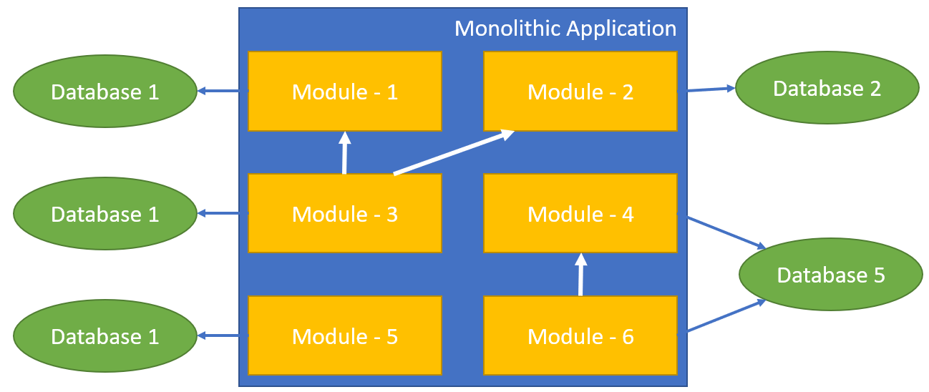
Part-I: From Monolithic to Microservice Modular Application / Separated Databases
Benefits
Better Scalability
Each database gets less load
Each database can be scaled independently
Schema Changes only affects the related module
Challenges
Cross-database joins is hard or impossible
Inter-module method calls
Data duplication / denormalization
Summary tables
Requires distributed transactions
But not supported by all database systems.

Slide 14
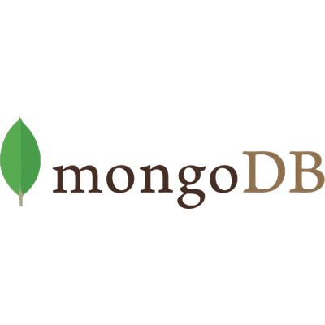

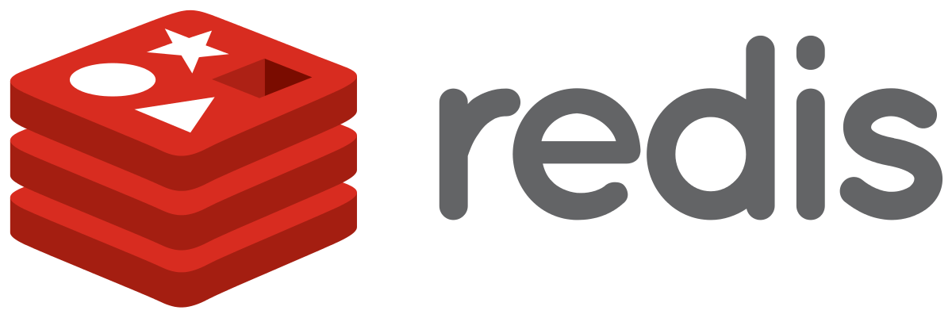
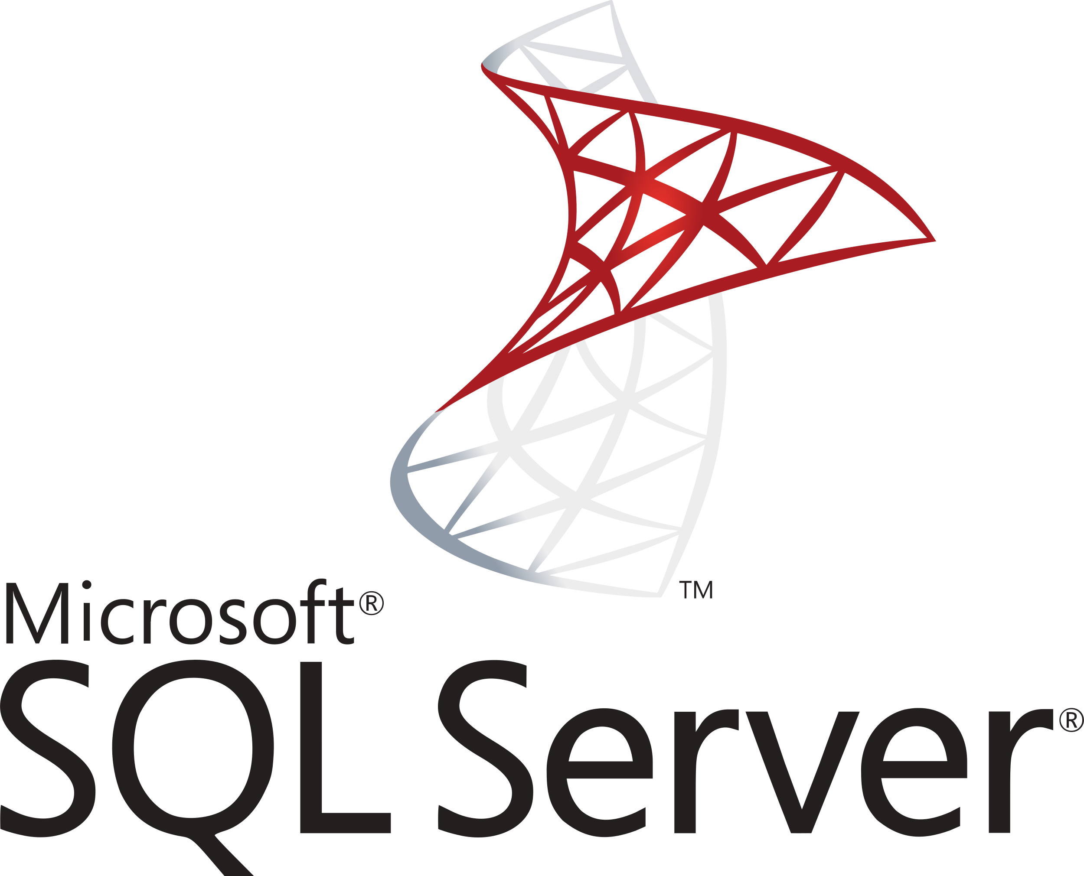
Part-I: From Monolithic to Microservice Modular Application / Polyglot Persistence
Monolithic Application
Module - 1
Module - 2
Module - 3
Module - 4
Module - 5
Module - 6

Slide 15
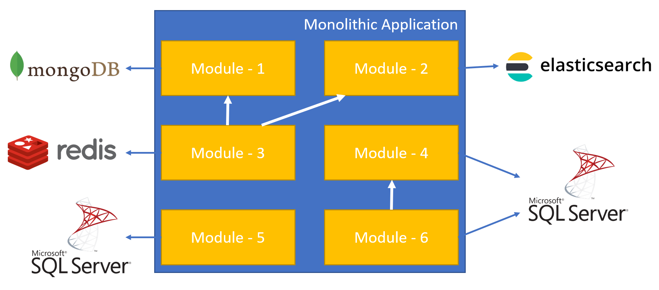
Part-I: From Monolithic to Microservice Modular Application / Separated Databases
Benefits
A module can use the best DBMS for it.
Challenges
Impossible to have cross-database joins and transactions

Slide 16
Part-I: From Monolithic to Microservice Distributed Services (SOA)
Web Application
3rd-Party Clients
server/container
server/container
Service - 1
Service - 3
server/container
Service - 2

Slide 17
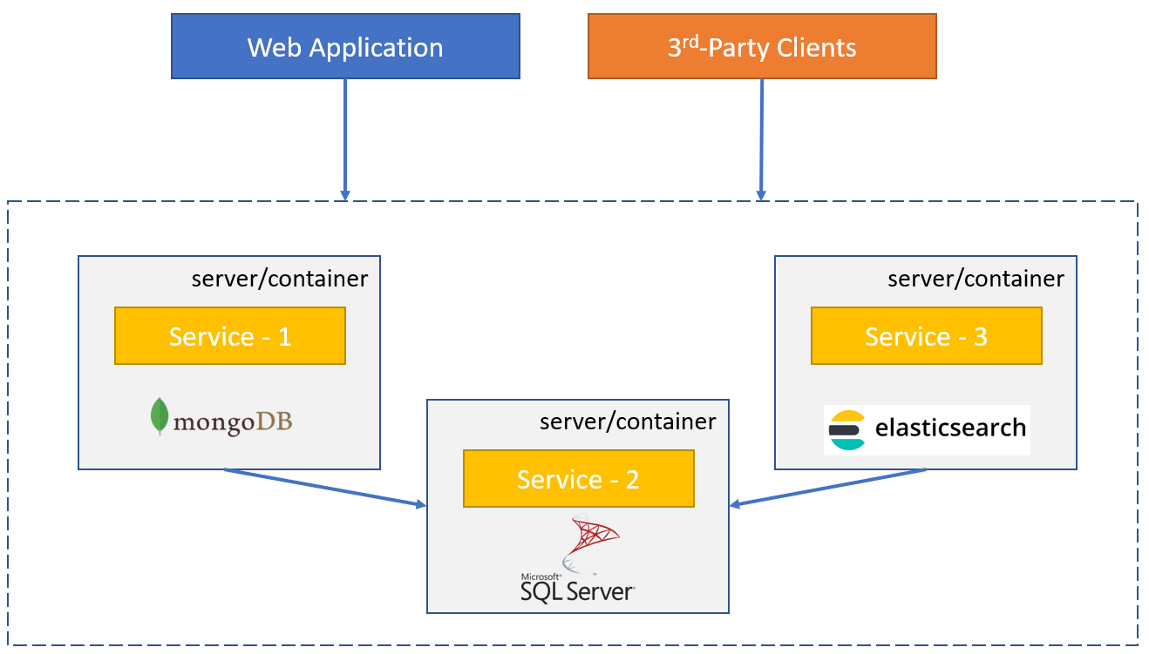
Part-I: From Monolithic to Microservice Modular Application / Separated Databases
Benefits
Better Scalability
Each service gets less load
Each service can be scaled independently
A service can be separately developed, versioned and deployed.
Every service can be developed using a different technology/platform/language as long as they use standard communication protocols (like TCP sockets, REST or GraphQL).

Slide 18
Part-I: From Monolithic to Microservice Modular Application / Separated Databases
Challenges
Complexity of service-to-service communication
Network delays
Security
Service downs
Bottlenecks
Multiple endpoints for clients?
Centralized logging
Code share may not be possible if you use different platforms (PHP, Java, Dotnet…)

Slide 19
Part-II The Implementation

Slide 20
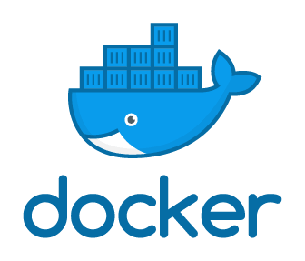
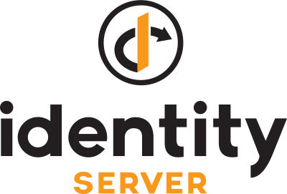




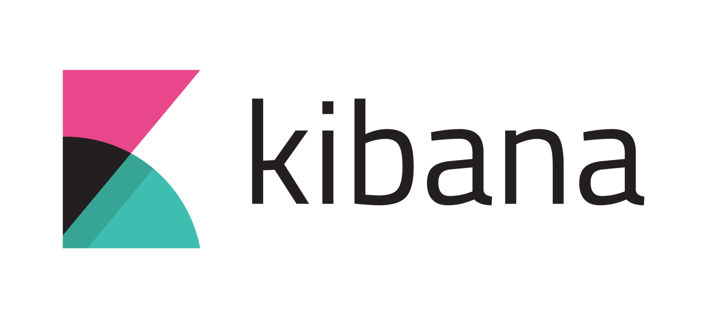
Part-II: The Implementation Overall Solution
Authentication Server
Identity Microservice
Backend Admin Application (MVC)
Backend App
Gateway
Internal
Gateway
Blogging Microservice
Public Web Site
(MVC)
Public Web Site
Gateway
Event Bus
Product Microservice
RabbitMQ
(Distributed Cache)
(Log Database)
(Data Visualization)

Slide 21
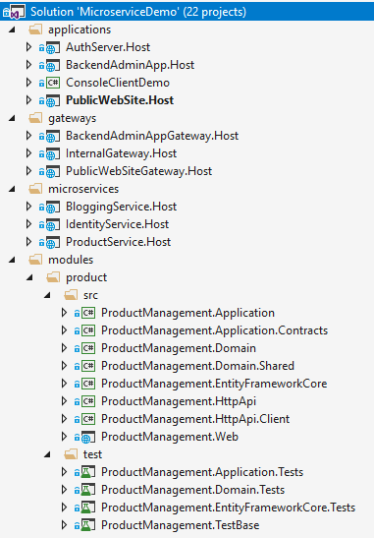
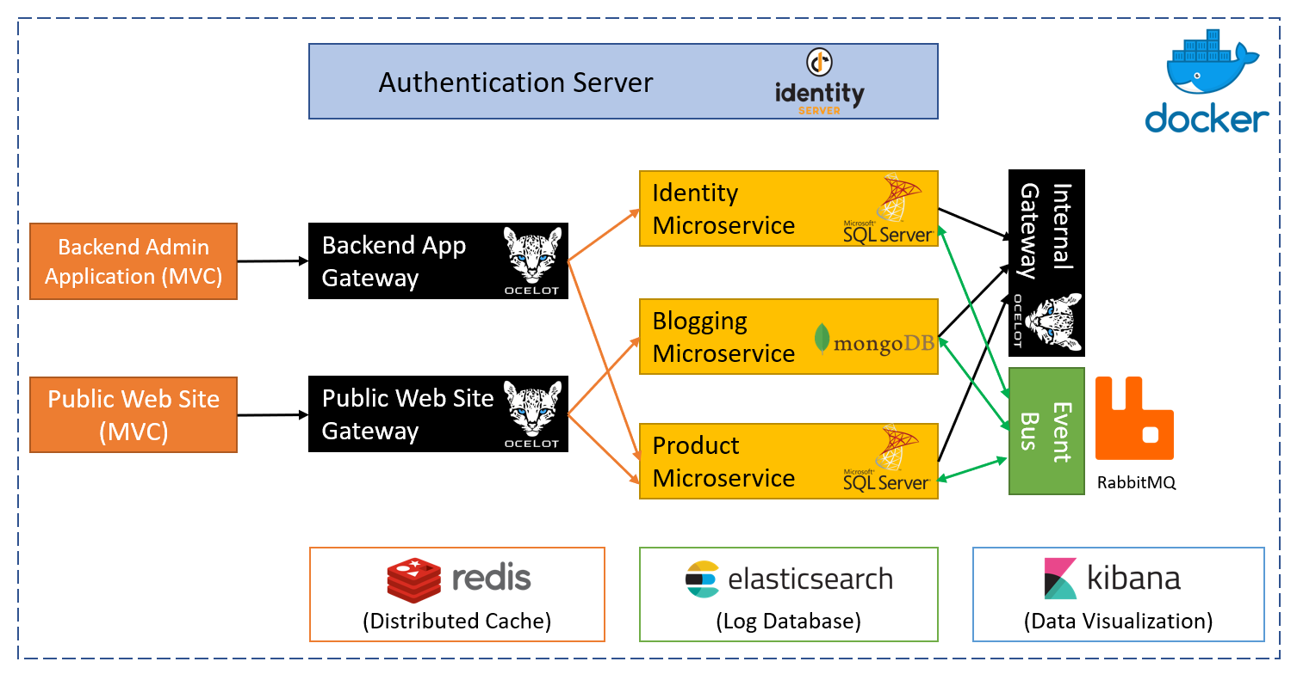
Part-II: The Implementation Overall Solution
Source code: http://bit.ly/ms-demo-source
Documentation: http://bit.ly/ms-demo-doc

Slide 22
Part-II: The Implementation Authentication with IdentityServer4
Open source OpenId Connect & OAuth 2.0 server
Main Features
Authentication as a Service
Access Control for APIs
Single sign on / sign out
User Authentication Flows (used in this solution)
Implicit/Hybrid
Client Secret
https://identityserver.io

Slide 23
Part-II: The Implementation Authentication with IdentityServer4
DEMO

Slide 24
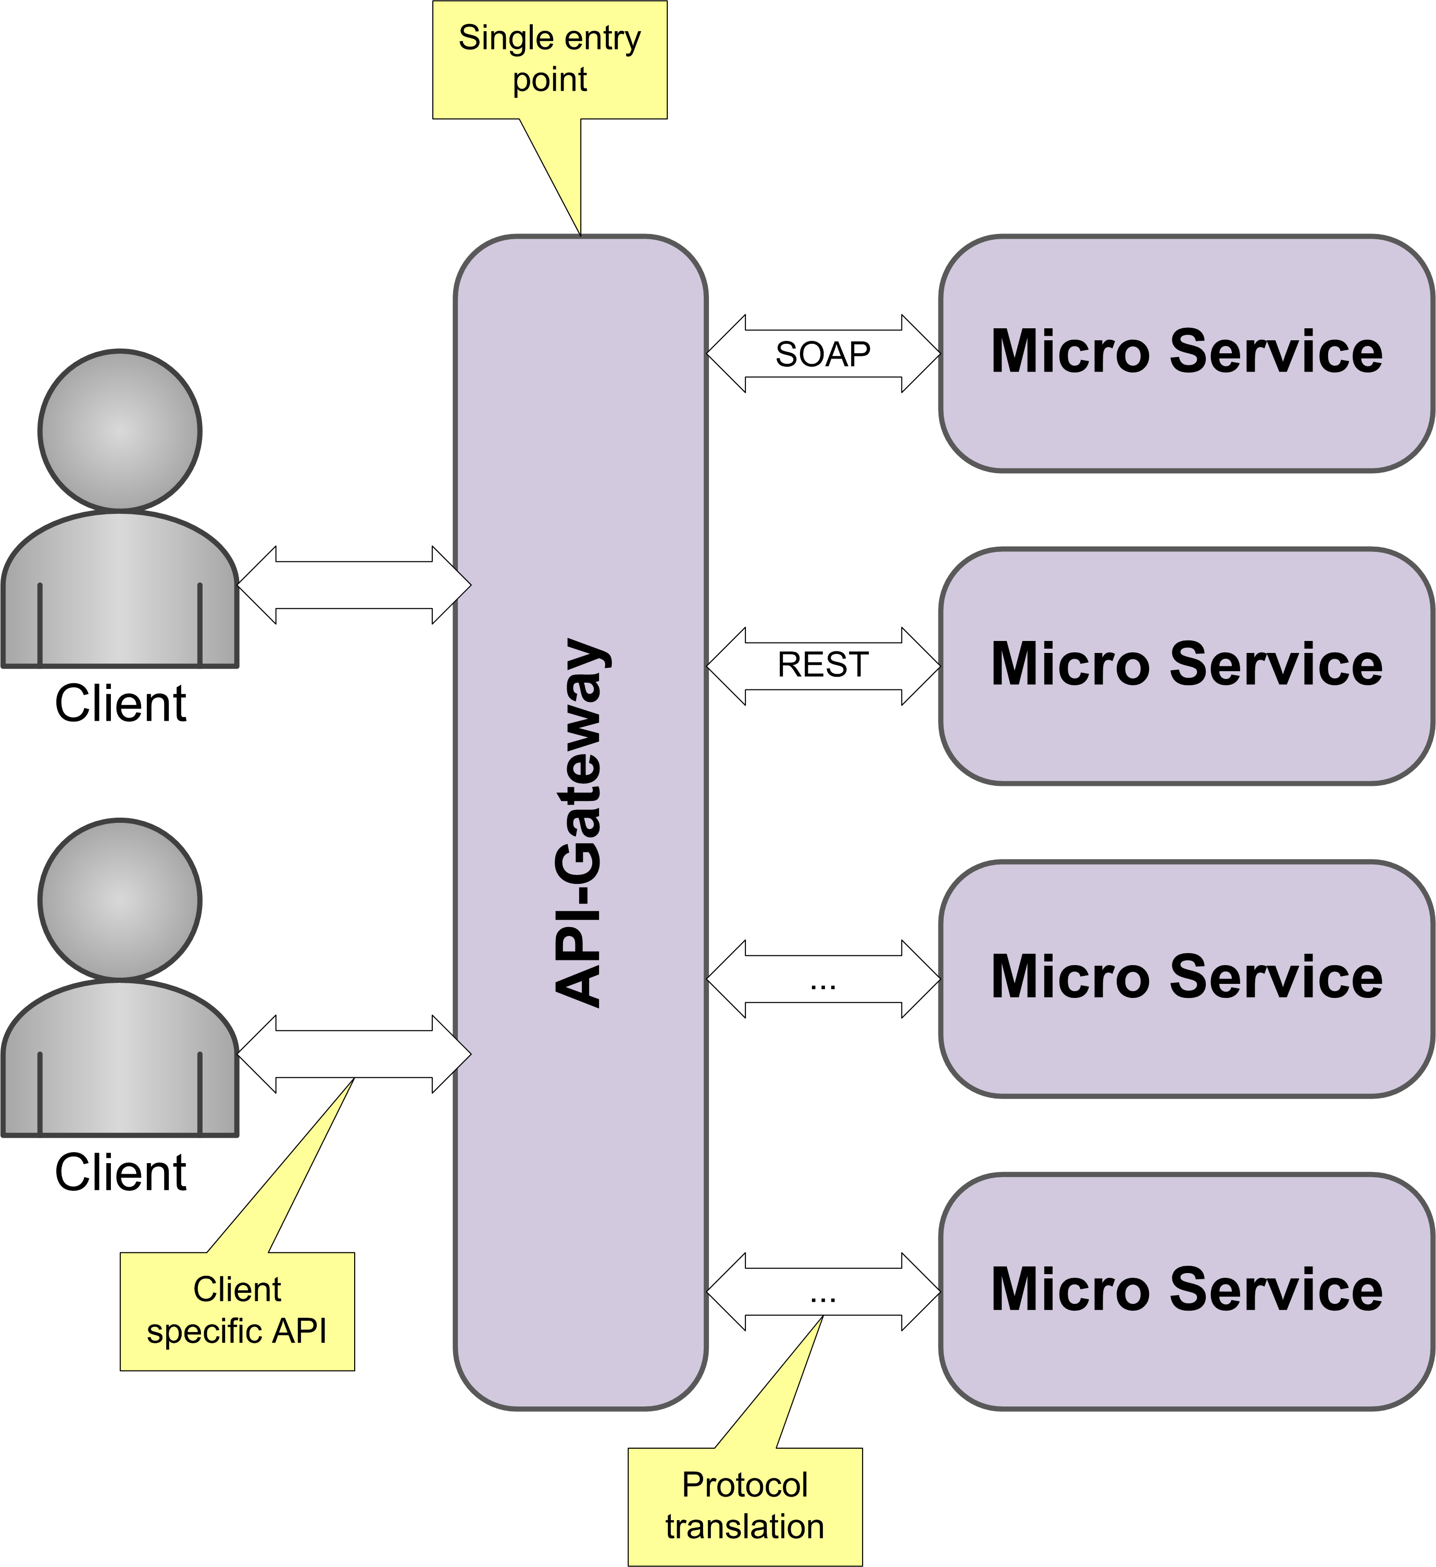
Part-II: The Implementation API Gateways / Overall
Single entrance point to the system for clients
Can be used as load balancer
Can provide;
Authentication
Rate limiting
Auditing
Routing
Protocol translation
…

Slide 25
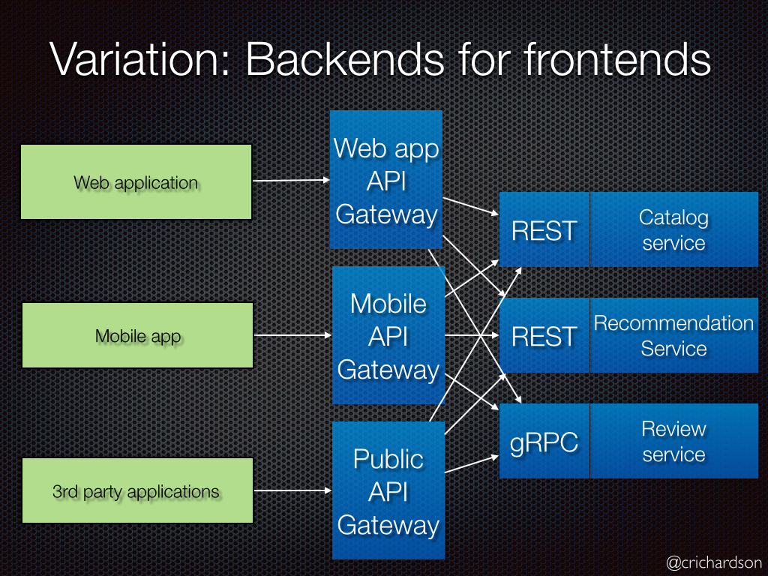
Part-II: The Implementation API Gateways / Backend For Frontend Pattern
Define a separate API Gateway for each kind of client
Each client may require different set of APIs
Each client may require different level of security, performance, logging, rate limiting, communication protocol… etc.
An Internal API Gateway can be used for inter-microservice communication

Slide 26
Part-II: The Implementation API Gateways / Ocelot Library
Open souce API Gateway
Routing
Load Balancing
Rate Limiting
Caching
Retry Policies
Authentication & Authorization
Service Discovery with Consul & Eureka
Request Aggregation
…
http://threemammals.com/ocelot

Slide 27
Part-II: The Implementation API Gateways / Ocelot Library
DEMO

Slide 28
Part-II: The Implementation Overall Solution

Slide 29
Part-II: The Implementation Overall Solution

